Slide 1

Period End Closing Execution (BSC)
Period End Closing Key Process Areas and New Period End Checks
Posting Period Control
Intercompany and Period End Closing
Lease Accounting and Period End Closing
Cost Management Closing Activities
Period End Closing for Accruals and Recurring Entries
Period End Data Checks
Asset Accounting Closing Activities
VAT Clearing and Reporting
GR/IR Closing Activities
Material Ledger Closing (Non-GSC Activities)
Automatic Clearing of LSC¹⁾ Accounts
G/L Closing Activities for Financial Statement Preparation
¹⁾ LSC – Accounts with indicator “Clearing Specific to Ledger Groups” active.

Slide 2

Asset Accounting Closing Overview
Lock FA Accounts from GR, IR and other postings
Capex WBS Settlement
Depreciation Run
Depreciation Expense Translation
T-Code: ZFFITCOMPANY_AS
T-Code:
CJB1, CJ8G
T-Code:
AFAR, AFAB
T-Code:
ZFAAU_DP01
FCC Task: Entity Level (Note task in FCC)
FCC Task: Entity Level
FCC Task: Entity Level
FCC Task: Entity Level
Timing: WD-1
Timing: WD-1 ¹⁾
Timing: WD-1
Timing: WD1 after Depreciation Run
There is no Fixed Asset related adjustments planned during Stat/Tax closing Key Timings. All adjustments to Fixed Assets in Stat/Tax are to be done within IFRS Key Timings.
¹⁾ Due to migration from ECC to S/4, there are still OPEX WBS elements which are part of a Capex Project migrated to S/4 as real OPEX WBS. These WBS elements still need to be settled to Cost Centers on WD2/WD3. These are different from the newly created OPEX WBS in S/4 which are statistical and do not require settlement.

Slide 3
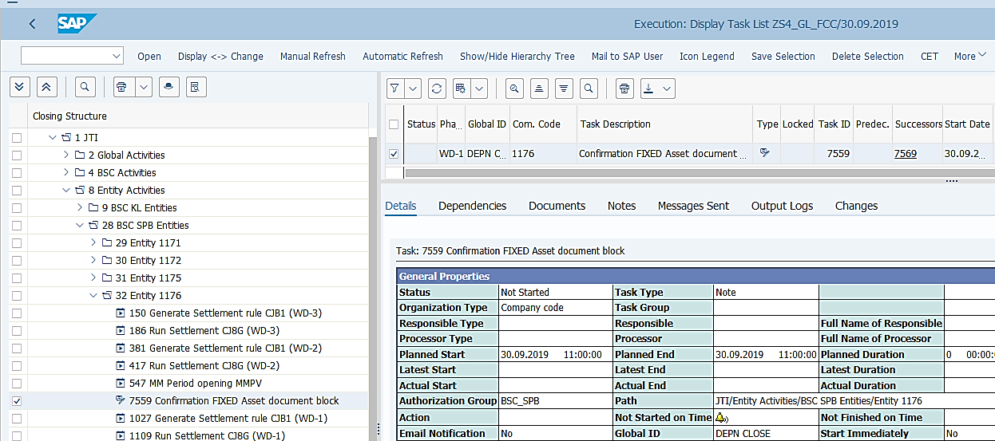
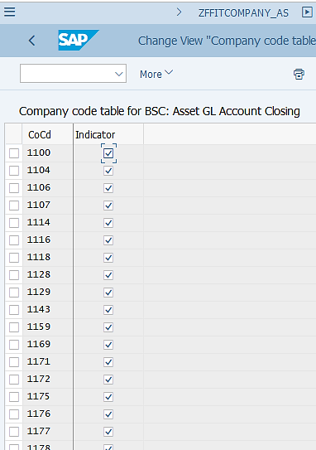
Lock Fixed Assets Related Postings
FCLOCO: FCC Task List Display
Lock Fixed Assets Related Postings prior to the commencement of Asset Accounting Close:
The purpose of this transaction is to stop any potential posting which may impact Fixed Assets accounts, which may come from Goods Receipt, Invoice Receipts and other postings.
This is a Note type task in FCC, meaning that it needs to be executed outside of FCC with a manually added comments and status change in the corresponding FCC task upon completion.
This task is the prerequisite of other Asset Accounting closing tasks, as determined in the FCC task property.
This task is controlled by local GBS/JTBC for individual entities and is executed on WD-1.

Slide 4
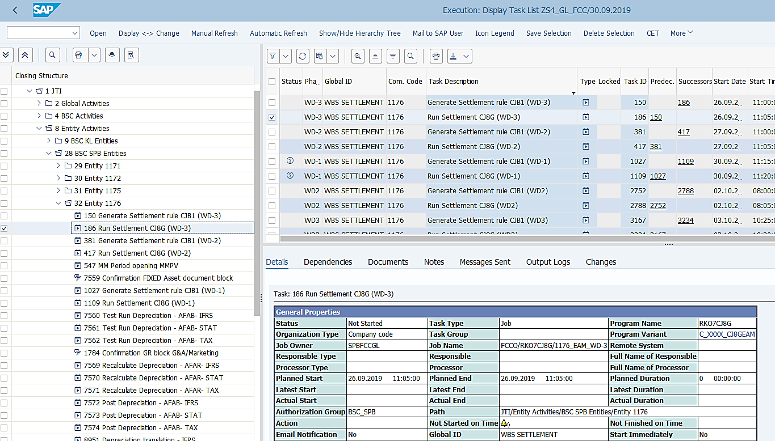
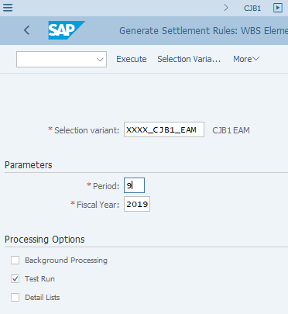
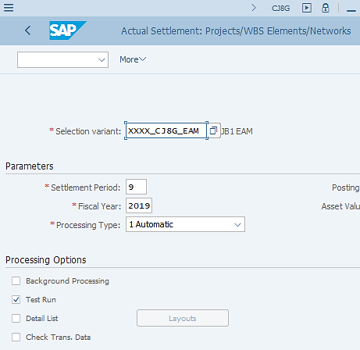
Capex WBS Settlement: Execution (1/3)
FCLOCO: FCC Task List Display
CJB1: Generate Settlement Rules
The process of WBS settlement for all types of WBS elements are the same. You can find detailed explanations in the Controlling WBS course materials.
CJ8G: WBS Settlement
These variants can’t be used directly for execution outside of FCC. See next slides for explanations.
Capex WBS Settlement:
According to JTI’s Enterprise Asset Management (EAM) process, the costs of Capex are first collected in Capex WBS elements. Capex WBS elements need to be settled so that Assets can be capitalized in Asset module. This is done after ZFFITCOMPANY_AS.
Some Capex WBS elements need their settlement rules to be generated before settlement can take place therefore you will need to execute CJB1 prior to CJ8G, which settlements selected WBS elements En Masse.
Please note that JTI also uses WBS solution in other processes such as Cost Management. The Capex related WBS activities need to be completed by WD-1 prior to Asset Depreciation, while other WBS activities continue until later working days.

Slide 5
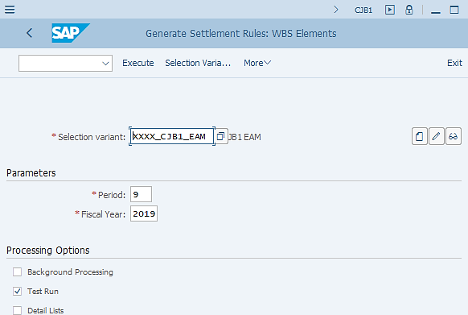
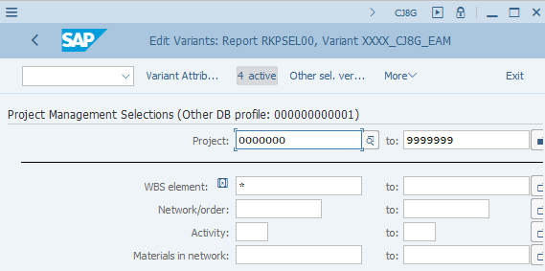
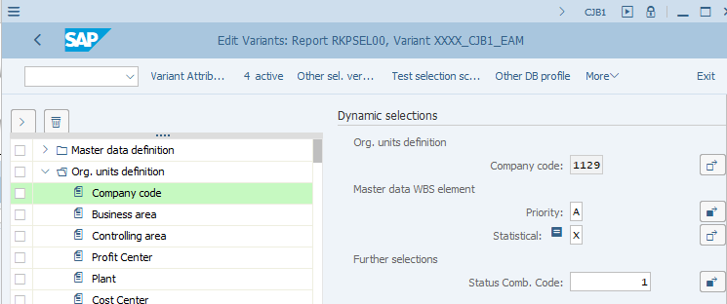
Capex WBS Settlement: Execution (2/3)
CJB1: Generate Settlement Rules -> Use “Change” or “Display” icons to see Variant Attributes of the selection variant
For T-Codes using “Selection Variants” in a transaction, such as CJB1, CJ8G, if the Selection Variant is a “global” or “GBS/JTBC” Variant, i.e. the company code selection within it is based on FCC folder structure, you will not be able to use them straight away when you want to execute the transactions outside of FCC, as the Company Code populated will most likely be incorrect.
As you can see from the screenshots, there are “4 active” Dynamic selection fields and one of them is Company Code. You can see in this example, only one company code is populated as the variant uses the standard variable for company code (explained earlier), and the system picks up the most recent one used by the user, which is not what we need when we wish to execute CJB1 outside of FCC.
We therefore need to change the Company Code field to include the company codes that are needed, for example all company codes belong to GBS St. Pete if I am executing this for St. Pete entities, or a specific company code if I am executing the transaction for a specific entity only. See how to do it on the next slide.

Slide 6
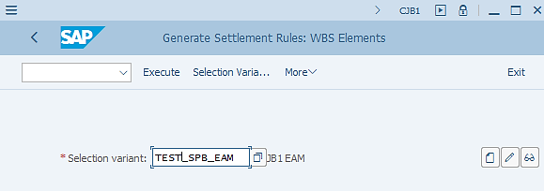
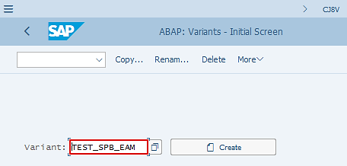
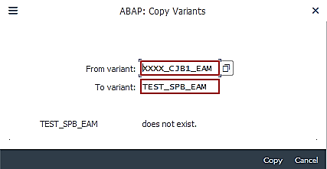
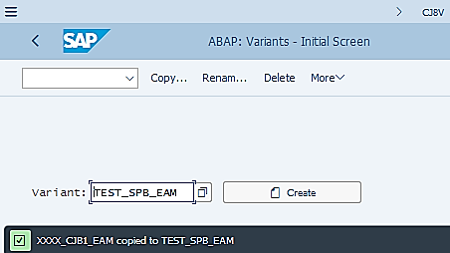
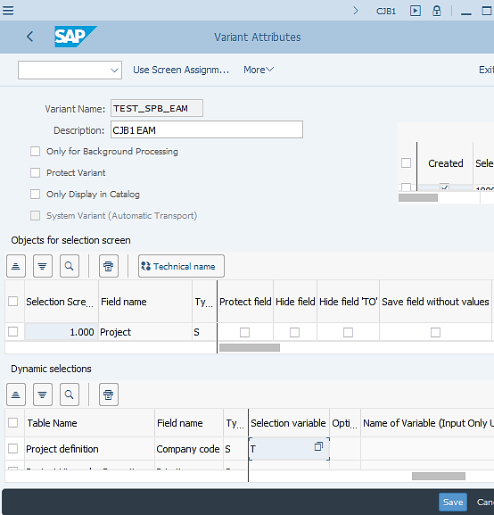
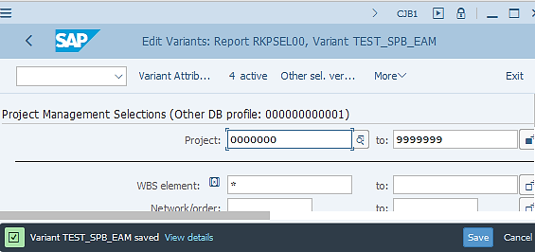
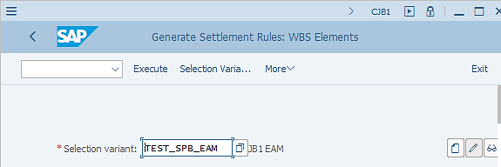
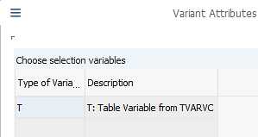
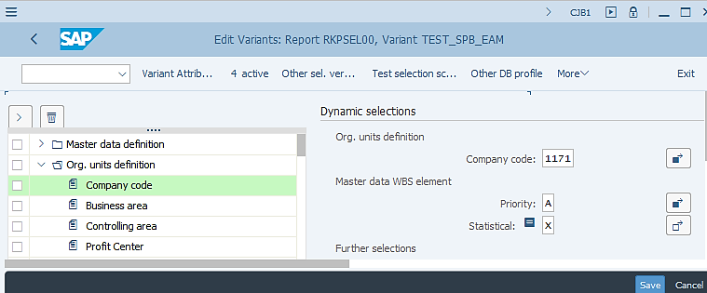
Capex WBS Settlement: Execution (3/3)
Select “Copy” from the menu.
3
Enter the “global variant” name in the From variant” field. Then click “Copy”.
6
In CJB1/CJ8G, enter a New Selection Variant Name, then click the “Create” icon.
4
Take note of the message and click “Back” to return to the original screen.
1
2
5
Select “Variant Attribute”.
9
You may want to amend the Description here.
8
Proceed to modify the newly copied variant by clicking the “Change” icon.
7
You need to choose a different “Selection variable type” – from T to blank
Upon Saving, you can use the new Selection Variant (e.g. TEST_SPB_EAM instead of XXXX_CJB1_EAM) for executing the transaction outside of FCC.
Now you should notice that Company Code selection is modifiable and you can edit it to include required company codes. Then save it.
10
12
13
Save your changes of Variant Attributes.
11

Slide 7
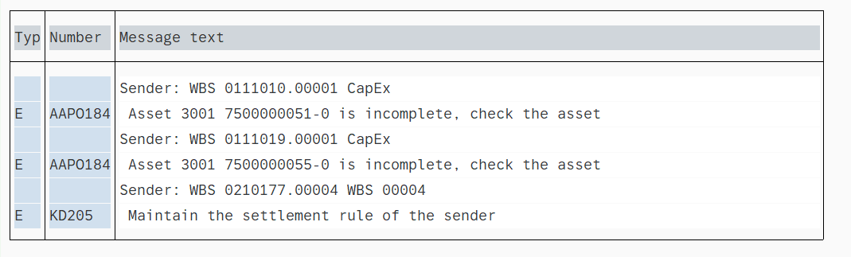
CAPEX WBS SETTLEMENT Common Error
Detail of the “Errors” can be checked from the “Output Logs”. GL Team needs to check the error and work as per the resolution mentioned below.
Errors | Error Description (Reason) | Resolution
Asset ***** is incomplete. | This error occurs when Asset Master Data is incomplete. | Ask the Market Team to update the Asset Master Data using the T-Code: AS02.

Slide 8
CAPEX WBS SETTLEMENT Common Error
Errors | Error Description (Reason) | Resolution
Maintain the settlement rule of sender | Missing settlement rules | Ask the market to put a rule via CJ12 or CJ20N. Once this is completed, the settlement needs to be re-run.
Status system LKD is active (WBS XXX) | The WBS is active and can't be settled | Ask the market to change the status on the WBS. Once this is actioned by the market, change the status to “checked” in FCC.
Acquisition value negative in area XX | Negative posting on asset is impossible | Edit the asset via AS02 to allow for negative values. The market should investigate on what happened on the WBS for consolidation purposes.
No Items to Settle | No WBS to be settled | This is OK as there are no assets in the Fixed Assets module. Change the status in FCC to “checked”.
WBS Element is not relevant | This error occurs when the variant has been changed. | Reconfirm the selection criteria is correct as incorrect WBS elements have tried to be processed. If unsure, check with Project Managers of the respective WBS (in WBS master data)
WBS Element has incorrect strategy ​ | This error occurs when the variant has been changed. | Reconfirm the selection criteria is correct as incorrect WBS elements have tried to be processed. If unsure, check with Project Managers of the respective WBS (in WBS master data)

Slide 9
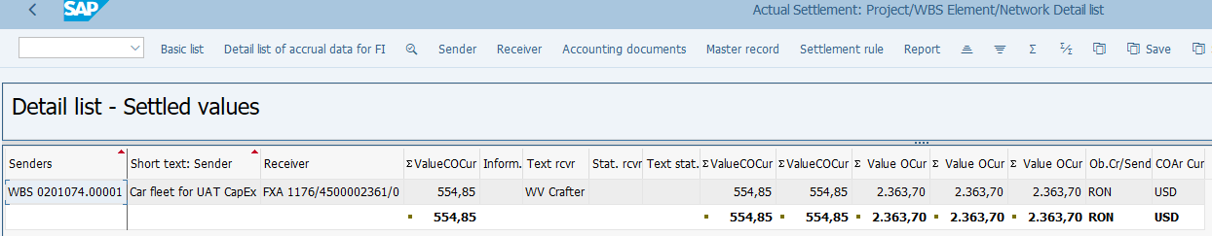
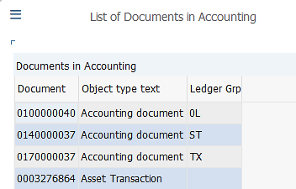
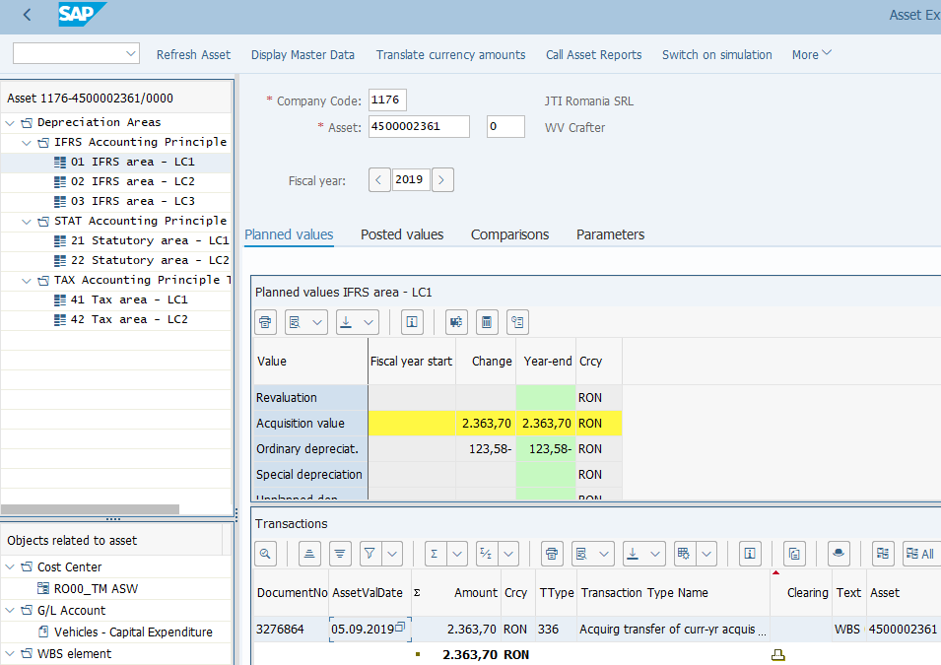
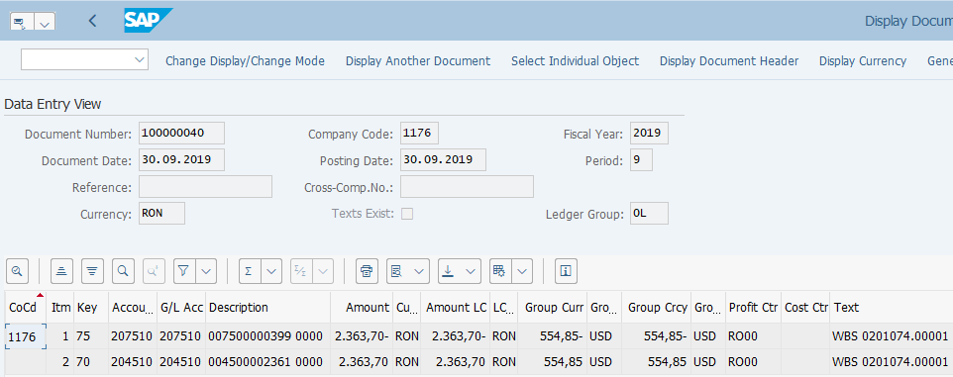
Capex WBS Settlement: Postings
Log from CJ8G WBS Settlement
AW01N: Asset Explorer
FB03: Display FI Document
Postings from Capex WBS Settlement:
Both Documents in Asset Accounting and Financial Accounting are posted upon WBS settlement.
As you can see from the above example, postings have been made to all three ledgers, each to a separate document. This is because the WBS may have received costs posted to different ledgers, which are then settled to the receiver with postings to the respective ledger (in respective Depreciation Areas of the receiving asset). If costs are posted to the WBS in all ledgers with the same amount, then the same amount will be settled to 3 ledgers via 3 different documents as shown in this example.

Slide 10
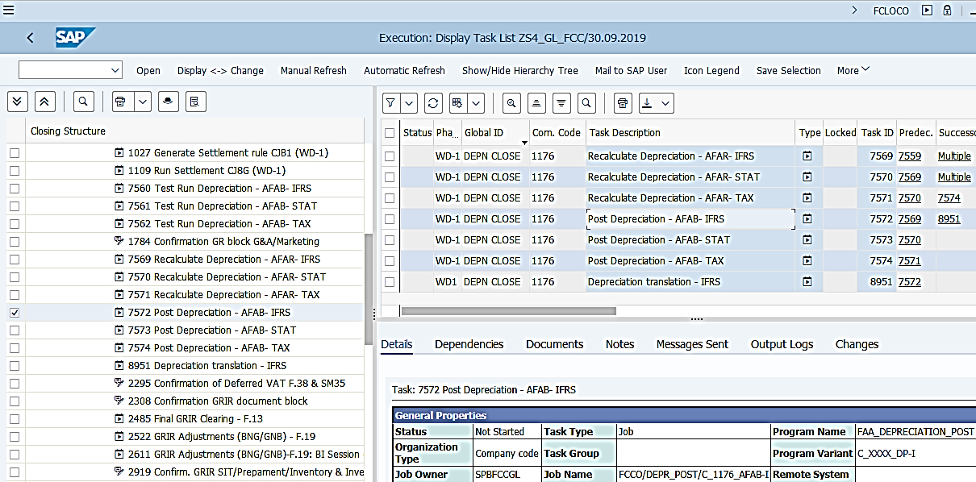
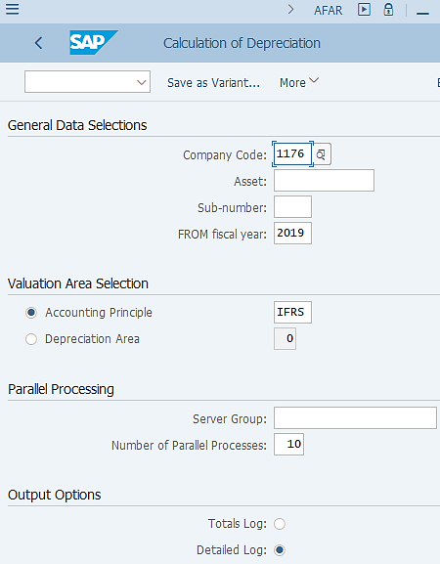
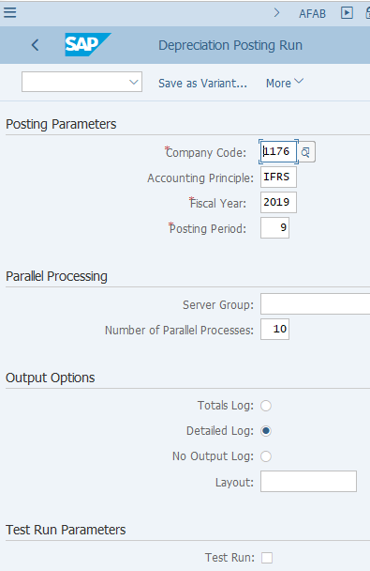
Depreciation Run: Execution
Both AFAR and AFAB tasks use “global variants”. Therefore it is important you review/amend the Company Code field and ensure the Fiscal Year and Posting Period are correct when executing them outside of FCC.
FCLOCO: FCC Task List Display
AFAR: Recalculate Depreciation
AFAB: Depreciation Run
Depreciation Run:
Depreciation run posts the monthly depreciation expenses of all active Assets (Fixed Assets, Right of Use for Leased Assets, Intangible Assets) registered in Asset module. In S/4 HANA this is done for different Accounting Principles linked to their corresponding ledgers.
In FCC, you will notice the following sequence of steps: Test Run Depreciation -> Recalculate Depreciation -> Depreciation Run. Test run is required to ensure all errors are checked and corrected before the update depreciation run. Recalculate Depreciation ensures that the correct Planned Depreciation values are updated so that they can be picked up during Depreciation Run.
Although on WD-1 only IFRS depreciation results are required for IFRS closing, the decision has been made that Depreciation Runs for all Accounting Principles are carried out at the same time for easy and logical management of the overall closing process, as well as to ensure the depreciation costs are correctly captured before Material Ledger closing can commence.
Detailed steps of Recalculate Depreciation and Depreciation Run are documented in Asset Accounting for GBS course materials. These functions have not changed from ECC to S/4 HANA, apart from introducing the Accounting Principle field. Make sure you remember to review/amend the Company Code and Fiscal year/Posting Period fields before executing the transactions outside of FCC.

Slide 11
DEPRECIATION RUN Common Error
Errors | Error Description (Reason) | Resolution
Company code XXXX not defined in Asset Accounting | Company code XXXX not defined in Asset Accounting | Manually change the status with the comment: no FA for depreciation
CO Account Assignments have different profit centers | CO Account Assignments have different profit centers | Manually change the status with the comment: warning ok

Slide 12
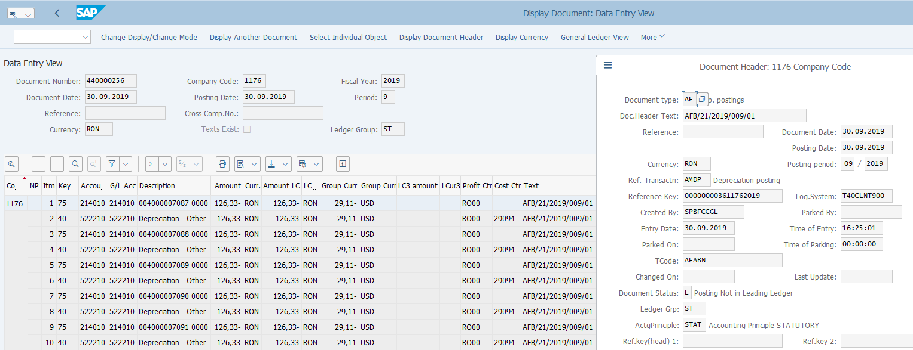
Depreciation Run: Postings
FB03: Display FI Documents
Depreciation Run Postings:
Depreciation Runs are carried out separately for each Accounting Principle therefore the postings are made to each ledger per run.
There are unique features of Depreciation Run documents, which help you to locate these documents, such as Document Type, TCode, Doc.Header Text, etc. The document numbers are also available in the output log of Depreciation Runs (accessible either at FCC task level or from SM37).
You can check the posted values in Asset module too, either via Asset Explorer (AW01N) or various Assets reports.

Slide 13
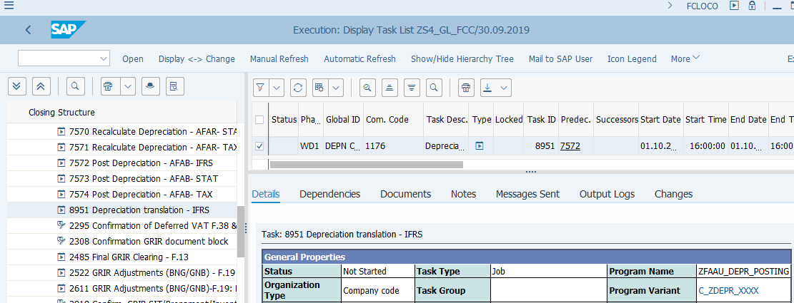
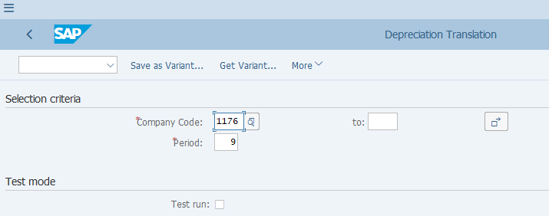
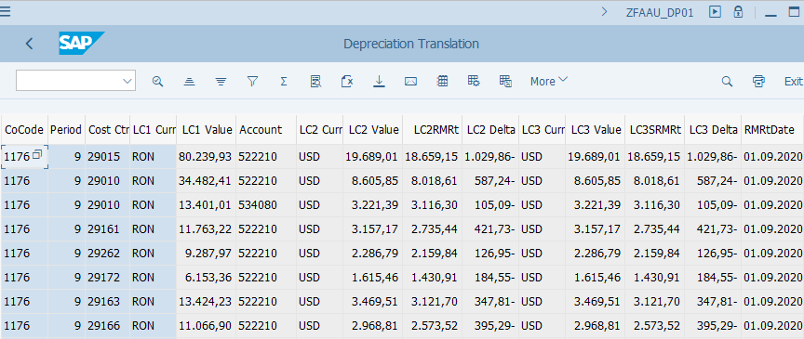
Depreciation Expense Translation: Execution
FCLOCO: FCC Task List Display
ZFAAU_DP01: Depr. Expense Translation
AFAB: Depreciation Run
Depreciation Expense Translation:
According to IFRS standards, Depreciation Expenses used in Product Costing should be calculated monthly using the average monthly rate (RM rate). However, Depreciation Expenses posted during Depreciation Runs are based on Historical Rate when Asset Capitalization was recorded.
To ensure the above IFRS standard was met, also taking into consideration of the timing of this adjustment, which should be done before the commencement of Material Ledger closing, Depreciation Expenses are translated after Depreciation Runs using RM rate (monthly average rate) in IFRS ledger.
This transaction is run for all non-USD entities, which is consistent with the requirement of P&L Translation, when all P&L account balances are translated to USD using RM rate at the end of the closing.
Please note that this T-Code should be executed only once right after Depreciation Run, which should take place on WD1.
Details of Depreciation Expense Translation can be found in the Asset Accounting course for GBS.

Slide 14
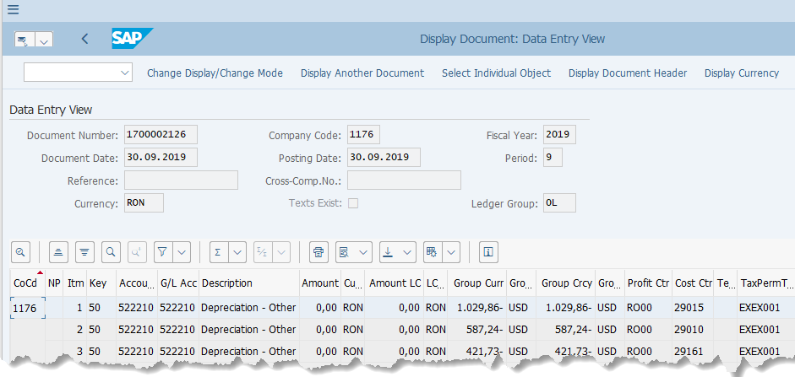
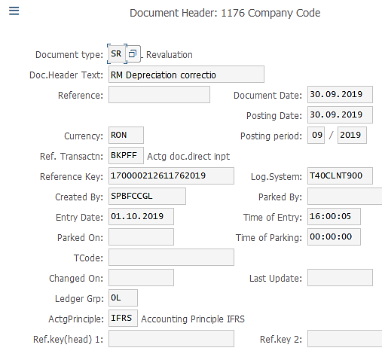

Depreciation Expense Translation: Postings
FB03: Display FI Documents
Depreciation Expense Translation Postings:
As this is a part of P&L translation in nature, the posting is made between the P&L accounts (Depreciation Expenses in this case) and the corresponding CTA account.
The postings are made with Document Type SR, which is the same for all Translation documents. It is posted to IFRS ledger only.

